Slide 1
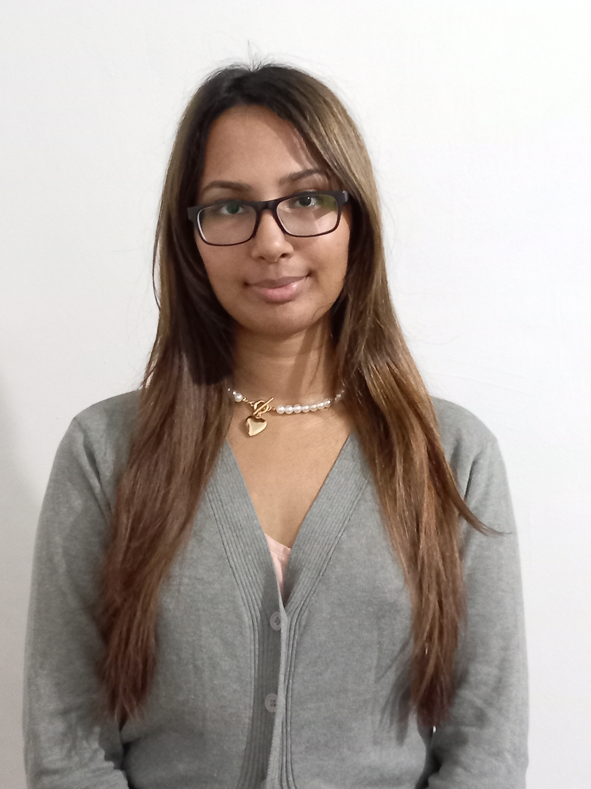
Curriculum Vitae

Slide 2
Personal information
Name: Ajanta Mostaq
Address: House Flat C/5, 21 Gaus Nagar, New Eskaton, Dhaka 1000
Phone: 01406121312
Email: mostaq.ajantaa@gmail.com

Slide 3
Education
2014 :
Qualification: Diplôme National du Brevet (Brevet)
Institution: Montpellier Academy (CNED), France
2016 :
Qualification: General Baccalaureate in Economic and Social
Institution: Montpellier Academy (CNED), France
2016-2022
Qualification: Bachelor in Political Science
Institution: Liege University, Belgium
2022-current
Qualification: Bachelor in Global Studies and Governance
Institution: Independent University of Bangladesh, Dhaka, Bangladesh

Slide 4
Work experience
Internship - Alliance Française de Dhaka, Dhaka, Bangladesh (2014)
Attended French classes
Read newspapers and checked off columns about Alliance Française
Learned how to do a press release and a post-press release
Completed a press release and a post-press release
Participated in exhibition preparation
Attended different exhibitions
Translated conference speaker's speeches from English to French

Slide 5
Skills and Languages
Computer skills | LANGUAGES
Word ZOTERO EXCEL GITHUB CANVAs | BENGALI FRENCH ENGLISH SPANISH THAI

Slide 6

Certificate
2013: Cambridge ESOL Entry Level Certificate in ESOL International (Entry 3), British Council, Bangladesh
2022: Interuniversity Test of Academic English (ITACE), Linguapolis, University of Antwerp, Belgium

